Slide 1
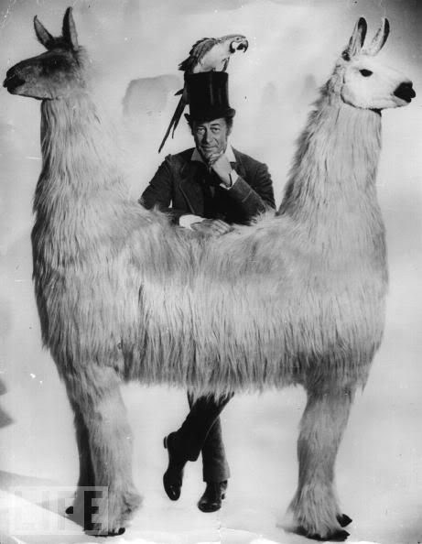
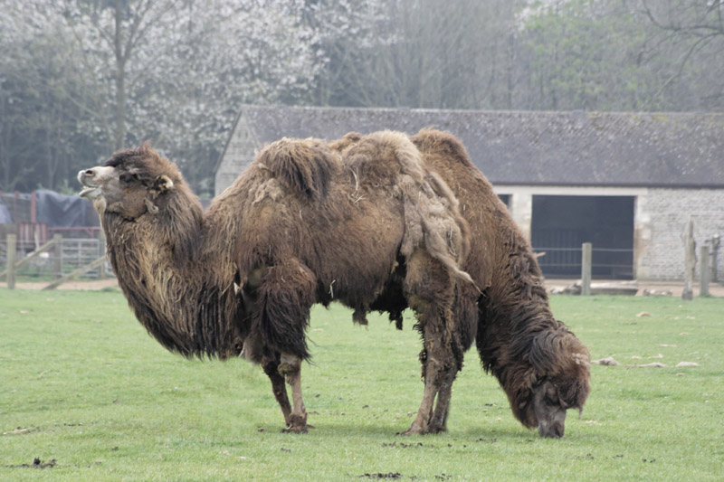
Push factors – Pull factors

Slide 2
Brainstorm Why do people move?
Individuals | Families
Communities | People Groups

Slide 3
Push factors: forces which act to drive people away from a place
Pull factors: forces that draw people to a new location.

Slide 4
Push factors are those that encourage a migrant to leave his place of residence. A migrant is more likely to understand push factors better than pull factors, because he is more familiar with the place where he is living than the place that he is moving too. Push factors may include such things as the cost of living, personal safety, environmental catastrophes or more minor issues such as weather and climate.
Pull factors are those that attract a migrant to a country. Often these are the migrant's perceptions of the physical, economic, social and political conditions of the country he plans to move to. Often these perceptions are based on what the migrant may have heard or read, rather than on what he has experienced. Sometimes these perceptions can be overly positive or incorrect.

Slide 5
Example: A young person has moved from a remote, rural area into the city. List possible push factors and pull factors.
Push factors
Pull factors
Limited job opportunities
Limited educational opportunities
Boring social life
Extensive travelling distances
No broadband / cell phone coverage
Everyone knows everyone else
More jobs
More educational opportunities
More freedom
Better shopping
Exciting social life
Bright lights – fast food
Better public facilities

